Slide 1
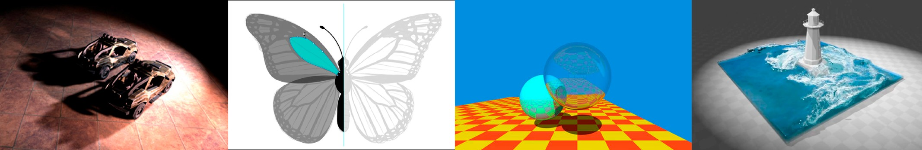
Introduction to Computer Graphics
Lecture 3: Transformation
http://www.cs.ucsb.edu/~lingqi/teaching/games101.html

Slide 2
Last Lecture
Vectors
Basic operations: addition, multiplication
Dot Product
Forward / backward (dot product positive / negative)
Cross Product
Left / right (cross product outward / inward)
Matrices

Slide 3
This Week
Transformation!
Today
-
-
-
-
-
-
Why study transformation
2D transformations: rotation, scale, shear Homogeneous coordinates
Composing transforms 3D transformations
Viewing transformation
View/Camera transformation
Projection transformation(Orthographic/Perspective)

Slide 4
Today
Why study transformation
Modeling
Viewing
2D transformations
Homogeneous coordinates

Slide 5
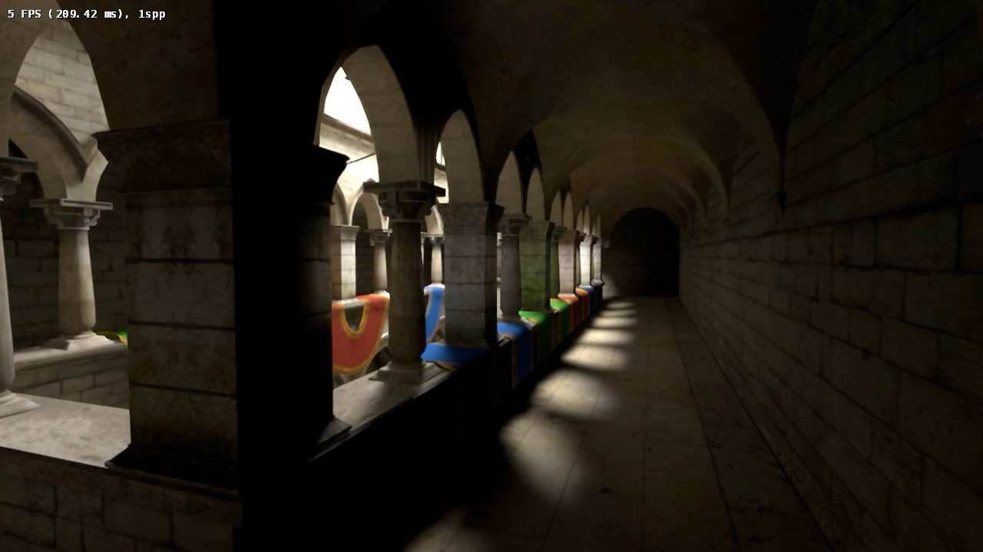
Why Transformation?
Modeling: translation
6
GAMES101 Lingqi Yan, UC Santa Barbara

Slide 6
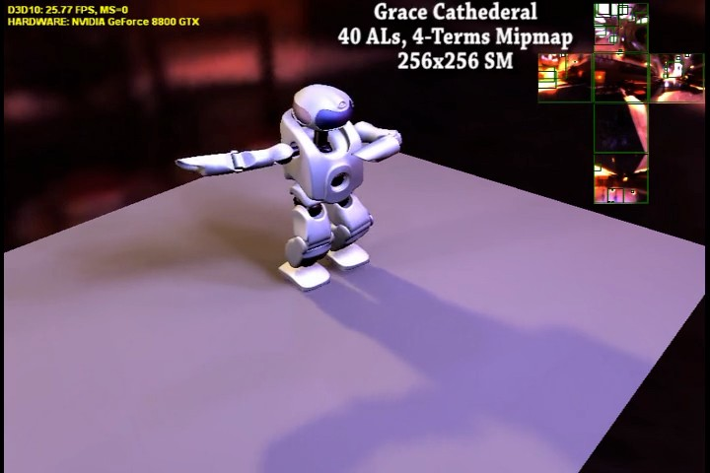
Why Transformation?
Modeling: rotation
7

Slide 7

Why Transformation?
Modeling: scaling
8
GAMES101 Lingqi Yan, UC Santa Barbara

Slide 8
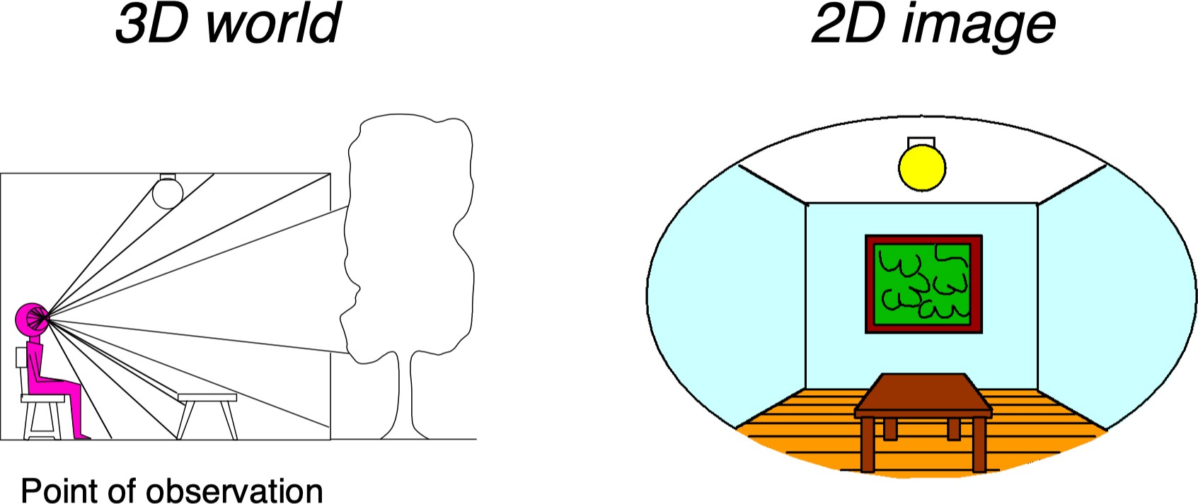
Why Transformation?
Viewing: (3D to 2D) projection

Slide 9
Today
Why study transformation
2D transformations
Representing transformations using matrices
Rotation, scale, shear
Homogeneous coordinates

Slide 10

Scale
S0.5

Slide 11
Scale Transform
S0.5
x' = sx y' = sy

Slide 12
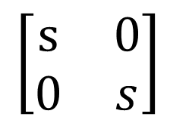
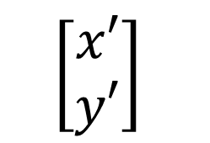
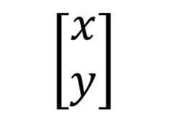
Scale Matrix
S0.5


$$\left[\begin{aligned}x′ \\ y′\end{aligned}\right]$$
=
$$\left[\begin{matrix}s & 0 \\ 0 & s\end{matrix}\right]$$
$$\left[\begin{aligned}x \\ y\end{aligned}\right]$$

Slide 13
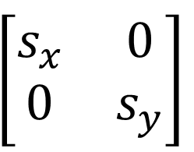
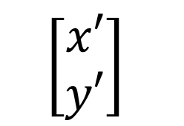

Scale (Non-Uniform)
S0.5,1.0
$$\left[\begin{aligned}x′ \\ y′\end{aligned}\right]$$

$$\left[\begin{matrix}s_{x} & 0 \\ 0 & s_{y}\end{matrix}\right]$$

=
$$\left[\begin{aligned}x \\ y\end{aligned}\right]$$

Slide 14

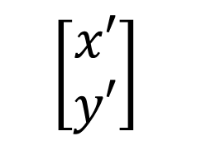
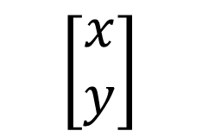
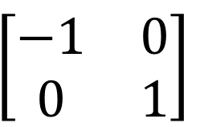
Reflection Matrix
Horizontal reflection:
x' = -x
y' = y


$$\left[\begin{aligned}x′ \\ y′\end{aligned}\right]$$
=
$$\left[\begin{matrix}−1 & 0 \\ 0 & 1\end{matrix}\right]$$
$$\left[\begin{aligned}x \\ y\end{aligned}\right]$$

Slide 15
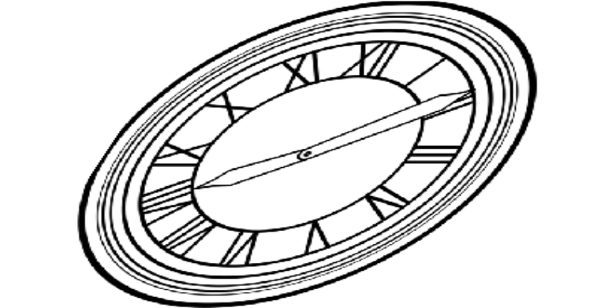
Shear Matrix
1
a
Hints:
Horizontal shift is 0 at y=0 Horizontal shift is a at y=1 Vertical shift is always 0


 

Slide 16
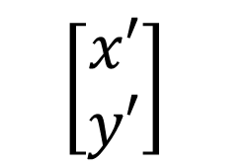
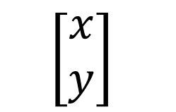
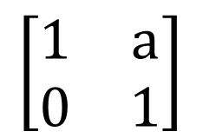
Shear Matrix
1
a
Hints:
Horizontal shift is 0 at y=0 Horizontal shift is a at y=1 Vertical shift is always 0


 
$$\left[\begin{aligned}x′ \\ y′\end{aligned}\right]$$
=
$$\left[\begin{matrix}1 & a \\ 0 & 1\end{matrix}\right]$$
$$\left[\begin{aligned}x \\ y\end{aligned}\right]$$

Slide 17
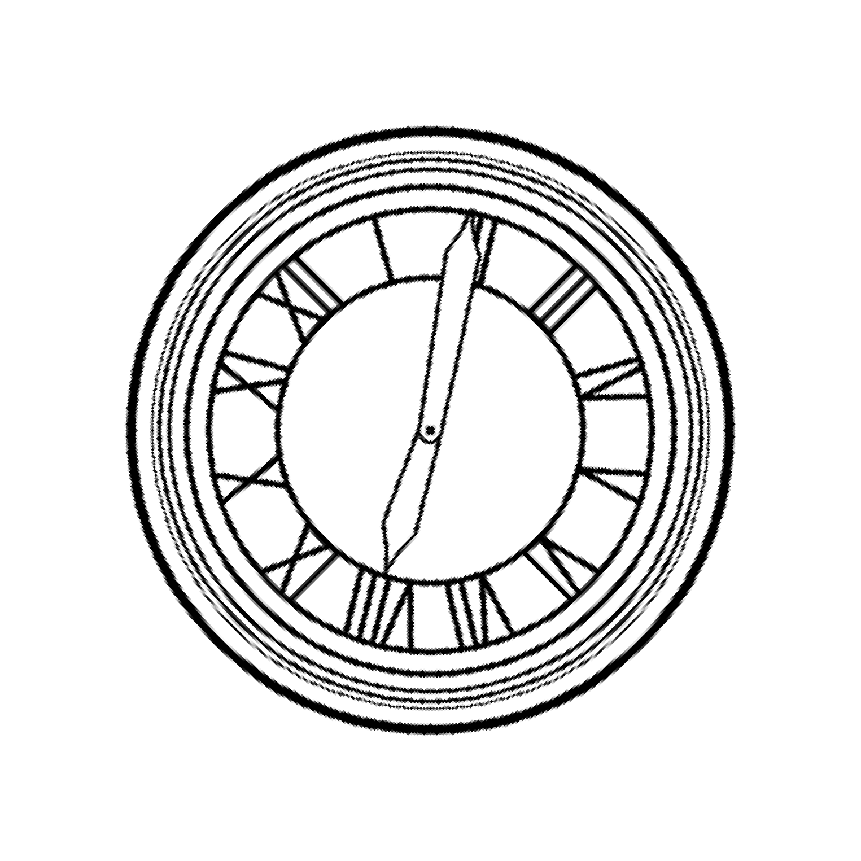
Rotate (about the origin (0, 0), CCW by default)
R45

Slide 18



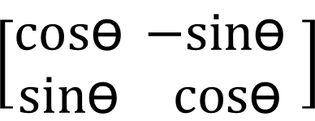
Rotation Matrix
- sin ө
cosө
✓
sin ө
cos ө

R =
$$\left[\begin{matrix}cos\text{ө} & −sin\text{ө} \\ sin\text{ө} & cos\text{ө} \end{matrix}\right]$$
ө

Slide 19
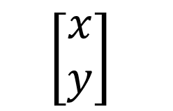
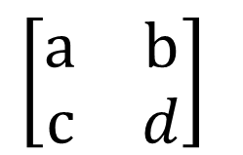
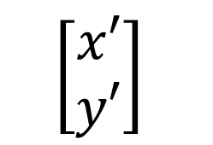
Linear Transforms = Matrices
(of the same dimension)
x' = a x + b y y' = c x + d y

$$\left[\begin{aligned}x′ \\ y′\end{aligned}\right]$$
=
$$\left[\begin{matrix}a & b \\ c & d\end{matrix}\right]$$
$$\left[\begin{aligned}x \\ y\end{aligned}\right]$$
x’ = M x

Slide 20
Questions?

Slide 21
Today
Why study transformation
2D transformations
Homogeneous coordinates
-
-
Why homogeneous coordinates Affine transformation

Slide 22

Ttx,ty
Translate
T1,1

Slide 23
Translation??
T1,1
Ttx,ty
x’ = x + t_{x} y’ = y + t_{y}

Slide 24


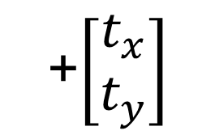
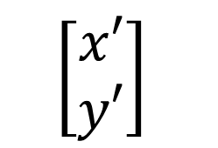
Why Homogeneous Coordinates
Translation cannot be represented in matrix form
  
$$\left[\begin{aligned}x′ \\ y′\end{aligned}\right]$$
$$\left[\begin{matrix}a & b \\ c & d\end{matrix}\right]$$
+$\left[\begin{aligned}t_{x} \\ t_{y}\end{aligned}\right]$
=
$$\left[\begin{aligned}x \\ y\end{aligned}\right]$$
(So, translation is NOT linear transform!)
But we don’t want translation to be a special case
Is there a unified way to represent all transformations? (and what’s the cost?)

Slide 25

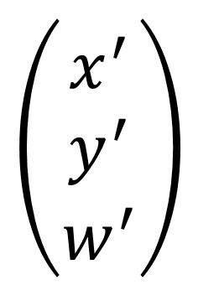
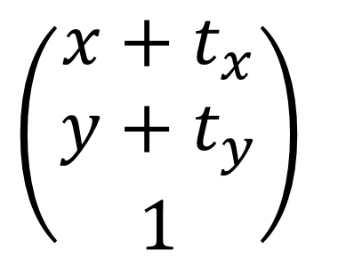

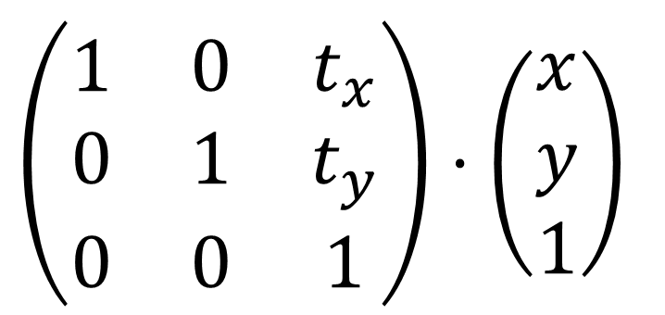
Solution: Homogenous Coordinates
Add a third coordinate (w-coordinate)
2D point = (x, y, 1)^{T}
2D vector = (x, y, 0)^{T}
Matrix representation of translations
$$\left(\begin{matrix}x^{′} \\ y^{′} \\ w^{′}\end{matrix}\right)$$
$$\left(\begin{matrix}1 & 0 & t_{x} \\ 0 & 1 & t_{y} \\ 0 & 0 & 1\end{matrix}\right)⋅\left(\begin{matrix}x \\ y \\ 1\end{matrix}\right)$$
$$\left(\begin{matrix}x+t_{x} \\ y+t_{y} \\ 1\end{matrix}\right)$$
$$=$$
$$=$$
What if you translate a vector?

Slide 26
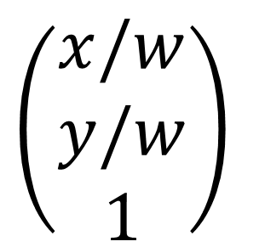
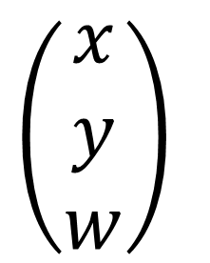
Homogenous Coordinates
Valid operation if w-coordinate of result is 1 or 0
vector | + vector | = vector
point | – point | = vector
point | + vector | = point
point | + point | = ??
In homogeneous coordinates,
$$\left(\begin{matrix}x \\ y \\ w\end{matrix}\right)$$
$$\left(\begin{matrix}x/w \\ y/w \\ 1\end{matrix}\right)$$
is the 2D point
w != 0.

Slide 27
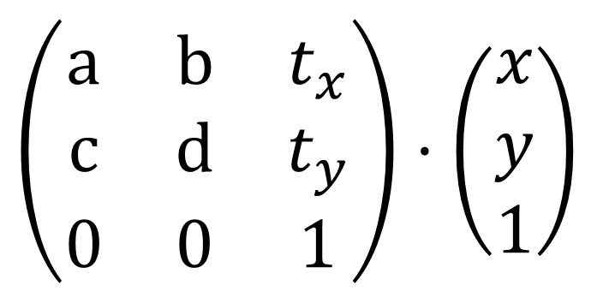
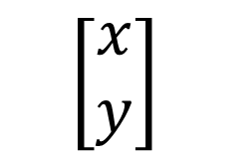

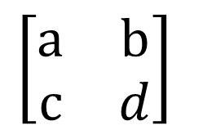
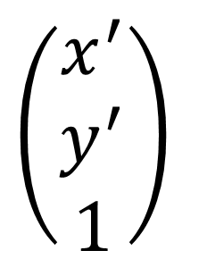
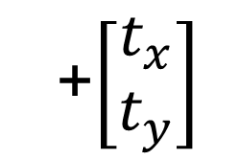
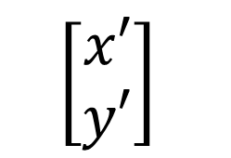
Affine Transformations
Affine map = linear map + translation
$$\left[\begin{aligned}x′ \\ y′\end{aligned}\right]$$
$$\left[\begin{matrix}a & b \\ c & d\end{matrix}\right]$$
+$\left[\begin{aligned}t_{x} \\ t_{y}\end{aligned}\right]$
=
$$\left[\begin{aligned}x \\ y\end{aligned}\right]$$
Using homogenous coordinates:
$$\left(\begin{matrix}x^{′} \\ y^{′} \\ 1\end{matrix}\right)$$
$$\left(\begin{matrix}a & b & t_{x} \\ c & d & t_{y} \\ 0 & 0 & 1\end{matrix}\right)⋅\left(\begin{matrix}x \\ y \\ 1\end{matrix}\right)$$
$$=$$

Slide 28
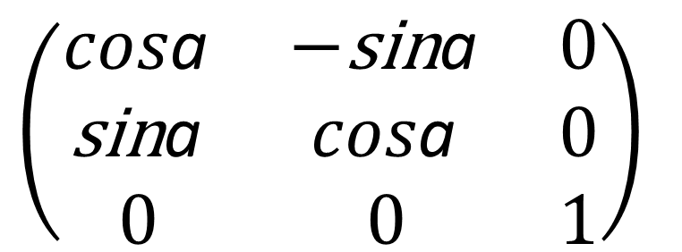
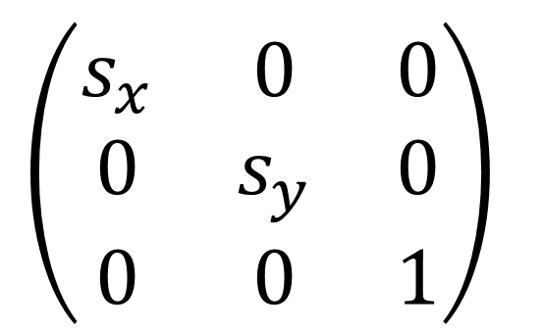
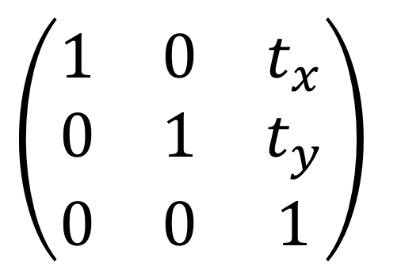
2D Transformations
Scale
$$\left(\begin{matrix}s_{x} & 0 & 0 \\ 0 & s_{y} & 0 \\ 0 & 0 & 1\end{matrix}\right)$$
S(s , s ) =
x y
Rotation
$$\left(\begin{matrix}cos\text{a} & −\text{sin}\text{a} & 0 \\ \text{sin}\text{a} & cos\text{a} & 0 \\ 0 & 0 & 1\end{matrix}\right)$$
R(a) =
Translation
$$\left(\begin{matrix}1 & 0 & t_{x} \\ 0 & 1 & t_{y} \\ 0 & 0 & 1\end{matrix}\right)$$
T(t , t ) =
x y

Slide 29



Inverse Transform
_{M}-1
M⁻¹ is the inverse of transform M in both a matrix and geometric sense
M
_{M}-1

Slide 30
Composing Transforms

Slide 31

Composite Transform
?

Slide 32
Translate Then Rotate?
T(1,0)
R45 · T(1,0)

Slide 33
Rotate Then Translate
R45
T(1,0) · R45

Slide 34


Transform Ordering Matters!
^{T}(1,0)
^{R}45 ^{· T}(1,0)
R45
T(1,0) · R45

Slide 35
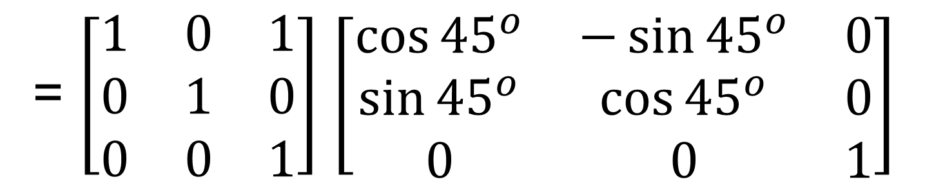
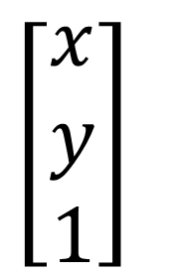
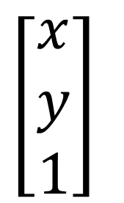
Transform Ordering Matters!
Matrix multiplication is not commutative
≠
R45 · T(1,0) T(1,0) · R45
Note that matrices are applied right to left:
$$\left[\begin{matrix}x \\ y \\ 1\end{matrix}\right]$$
= $\left[\begin{matrix}1 & 0 & 1 \\ 0 & 1 & 0 \\ 0 & 0 & 1\end{matrix}\right]$ $\left[\begin{matrix}\cos{{45}^{o}} & −\sin{{45}^{o}} & 0 \\ \sin{{45}^{o}} & \cos{{45}^{o}} & 0 \\ 0 & 0 & 1\end{matrix}\right]$
$$\left[\begin{matrix}x \\ y \\ 1\end{matrix}\right]$$
T(1,0) · R45

Slide 36
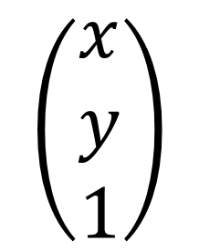
Composing Transforms
Sequence of affine transforms A₁, A₂, A₃, ...
Compose by matrix multiplication
Very important for performance!
$$\left(\begin{matrix}x \\ y \\ 1\end{matrix}\right)$$
A (
. . . A
(A (x))) = A
· · · A
· A ·
n
2 1
n
2
1
Pre-multiply n matrices to obtain a single matrix representing combined transform

Slide 37


Decomposing Complex Transforms
How to rotate around a given point c?
Translate center to origin
Rotate
Translate back
T(-c)
R(a)
T(c)
Matrix representation?
T(c) · R(a) · T(-c)

Slide 38
3D Transforms

Slide 39
3D Transformations
Use homogeneous coordinates again:
3D point = (x, y, z, 1)^{T}
3D vector = (x, y, z, 0)^{T}
In general, (x, y, z, w) (w != 0) is the 3D point:
(x/w, y/w, z/w)

Slide 40
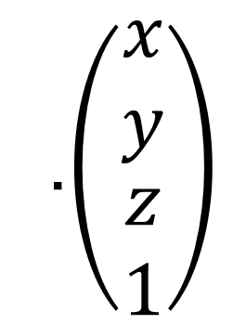
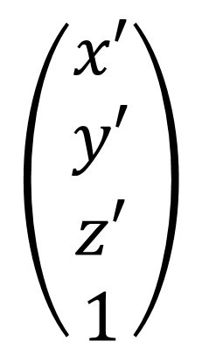
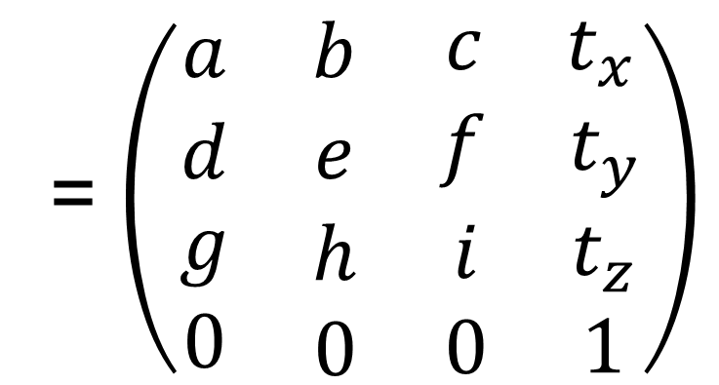
3D Transformations
Use 4×4 matrices for affine transformations
$$\left(\begin{matrix}x′ \\ y′ \\ \begin{aligned}z′ \\ 1\end{aligned}\end{matrix}\right)$$
= $\left(\begin{matrix}a & b & \begin{matrix}c & t_{x}\end{matrix} \\ d & e & \begin{matrix}f & t_{y}\end{matrix} \\ \begin{matrix}g \\ 0\end{matrix} & \begin{matrix}h \\ 0\end{matrix} & \begin{matrix}\begin{matrix}i \\ 0\end{matrix} & \begin{matrix}t_{z} \\ 1\end{matrix}\end{matrix}\end{matrix}\right)$
.$\left(\begin{matrix}x \\ y \\ \begin{aligned}z \\ 1\end{aligned}\end{matrix}\right)$
What’s the order?
Linear Transform first or Translation first?

Slide 41
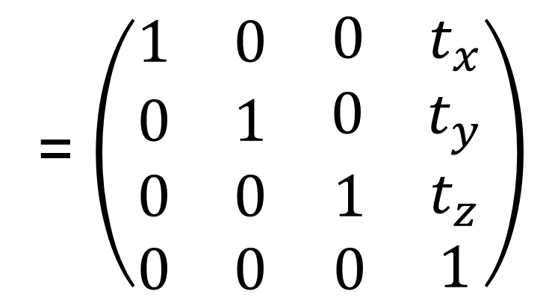
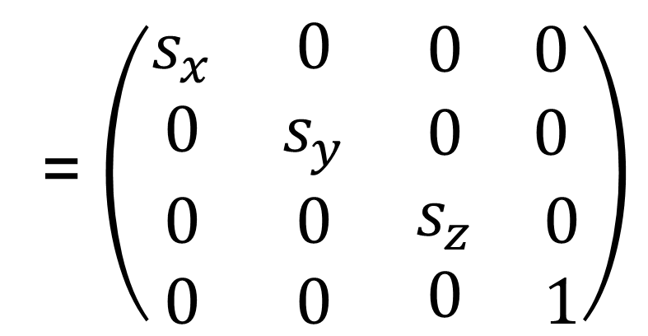
3D Transformations
= $\left(\begin{matrix}s_{x} & 0 & \begin{matrix}0 & 0\end{matrix} \\ 0 & s_{y} & \begin{matrix}0 & 0\end{matrix} \\ \begin{matrix}0 \\ 0\end{matrix} & \begin{matrix}0 \\ 0\end{matrix} & \begin{matrix}\begin{matrix}s_{z} \\ 0\end{matrix} & \begin{matrix}0 \\ 1\end{matrix}\end{matrix}\end{matrix}\right)$
Scale
S(s_{x}, s_{y} , s_{z} )
Translation
= $\left(\begin{matrix}1 & 0 & \begin{matrix}0 & t_{x}\end{matrix} \\ 0 & 1 & \begin{matrix}0 & t_{y}\end{matrix} \\ \begin{matrix}0 \\ 0\end{matrix} & \begin{matrix}0 \\ 0\end{matrix} & \begin{matrix}\begin{matrix}1 \\ 0\end{matrix} & \begin{matrix}t_{z} \\ 1\end{matrix}\end{matrix}\end{matrix}\right)$
T(t_{x}, t_{y} , t_{z} )

Slide 42
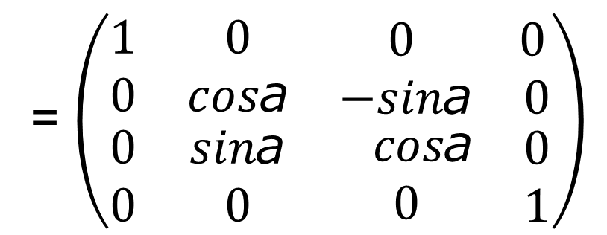


3D Transformations
Rotation around x-, y-, or z-axis
y
Rotation around x-axis
= $\left(\begin{matrix}1 & 0 & \begin{matrix} 0 & 0\end{matrix} \\ 0 & cos\text{a} & \begin{matrix}−sin\text{a} & 0\end{matrix} \\ \begin{matrix}0 \\ 0\end{matrix} & \begin{matrix}sin\text{a} \\ 0\end{matrix} & \begin{matrix}\begin{matrix} cos\text{a} \\ 0\end{matrix} & \begin{matrix}0 \\ 1\end{matrix}\end{matrix}\end{matrix}\right)$
R (a)
x
x
= $\left(\begin{matrix}cos\text{a} & 0 & \begin{matrix} sin\text{a} & 0\end{matrix} \\ 0 & 1 & \begin{matrix}0 & 0\end{matrix} \\ \begin{matrix}−sin\text{a} \\ 0\end{matrix} & \begin{matrix}0 \\ 0\end{matrix} & \begin{matrix}\begin{matrix} cos\text{a} \\ 0\end{matrix} & \begin{matrix}0 \\ 1\end{matrix}\end{matrix}\end{matrix}\right)$
z
R_{y} (a)
= $\left(\begin{matrix}cos\text{a} & −sin\text{a} & \begin{matrix} 0 & 0\end{matrix} \\ sin\text{a} & cos\text{a} & \begin{matrix}0 & 0\end{matrix} \\ \begin{matrix}0 \\ 0\end{matrix} & \begin{matrix}0 \\ 0\end{matrix} & \begin{matrix}\begin{matrix}1 \\ 0\end{matrix} & \begin{matrix}0 \\ 1\end{matrix}\end{matrix}\end{matrix}\right)$
Anything strange about Ry?
R (a)
z

Slide 43


3D Rotations
Compose any 3D rotation from Rx, Ry, Rz?
So-called Euler angles
Often used in flight simulators: roll, pitch, yaw

Slide 44

Rodrigues’ Rotation Formula
Rotation by angle α around axis n
How to prove this magic formula?
Check out the supplementary material on the course website!

Slide 45
View Transformation
Viewing transformation
-
-
View / Camera transformation
Projection transformation
-
-
Orthographic projection
Perspective projection

Slide 46
View / Camera Transformation
What is view transformation?
Think about how to take a photo
-
-
-
Find a good place and arrange people (model transformation) Find a good “angle” to put the camera (view transformation) Cheese! (projection transformation)

Slide 47

View / Camera Transformation
How to perform view transformation?
Define the camera first
Up direction
-
-
-
Position
$$\vec{e}$$
Look-at / gaze direction gˆ
Up direction
_{t}ˆ
(assuming perp. to look-at)
Position
Look-at direction

Slide 48





View / Camera Transformation
Key observation
- If the camera and all objects move together, the “photo” will be the same
Y
==
(0, 0, 0) -Z
X
How about that we always transform the camera to
-
-
The origin, up at Y, look at -Z
And transform the objects along with the camera

Slide 49





View / Camera Transformation
Transform the camera by M_{view}
- So it’s located at the origin, up at Y, look at -Z
Mview in math?
_{t}ˆ
-
-
-
-
-
Translates e to origin Rotates g to -Z Rotates t to Y Rotates (g x t) To X Difficult to write!
$$\vec{e}$$
gˆ
Y
-Z
X

Slide 50


View / Camera Transformation
Mview
in math?
-
-
Let’s write M_{view} = R_{view} T_{view}
Translate e to origin
-
-
Rotate g to -Z, t to Y, (g x t) To X
Consider its inverse rotation: X to (g x t), Y to t, Z to -g

Slide 51
View / Camera Transformation
Summary
-
-
Transform objects together with the camera Until camera’s at the origin, up at Y, look at -Z
Also known as ModelView Transformation
But why do we need this?
- For projection transformation!

Slide 52

Projection Transformation
Projection in Computer Graphics
-
-
-
3D to 2D
Orthographic projection Perspective projection
Orthographic projection
Perspective projection
Fig. 7.1 from Fundamentals of Computer Graphics, 4th Edition

Slide 53

Projection Transformation
Perspective projection vs. orthographic projection
https://stackoverflow.com/questions/36573283/from-perspective-picture-to-orthographic-picture

Slide 54

Orthographic Projection
A simple way of understanding
-
-
-
Camera located at origin, looking at -Z, up at Y (looks familiar?) Drop Z coordinate
Translate and scale the resulting rectangle to [-1, 1]²

Slide 55

Orthographic Projection
In general
- We want to map a cuboid [l, r] x [b, t] x [f, n] to the “canonical ” cube [-1, 1]³
t
f
y
y
y
n
Translate
Scale
l r
b
x
x
x
z
z
z

Slide 56
Orthographic Projection
Slightly diﬀerent orders (to the “simple way”)
-
-
Center cuboid by translating Scale into “canonical” cube
t
f
y
y
y
n
Translate
Scale
l r
b
x
x
x
z
z
z

Slide 57

Orthographic Projection
Transformation matrix?
- Translate (center to origin) first, then scale (length/width/height to 2)
t
f
y
y
y
n
Translate
Scale
l r
b
x
x
x
z
z
z

Slide 58
Orthographic Projection
Caveat
-
-
Looking at / along -Z is making near and far not intuitive (n > f) FYI: that’s why OpenGL (a Graphics API) uses left hand coords.
t
f
y
y
y
n
Translate
Scale
l r
b
x
x
x
z
z
z

Slide 59
Perspective Projection
Most common in Computer Graphics, art, visual system
Further objects are smaller
Parallel lines not parallel; converge to single point
A
A’
B
B’
Center of projection (camera/eye location)
Image Plane, or
Plane of Projection

Slide 60


Perspective Projection
Euclid was wrong??!!
https://en.wikipedia.org/wiki/Parallel_(geometry)

Slide 61
Perspective Projection
Before we move on
Recall: property of homogeneous coordinates
-
-
(x, y, z, 1), (kx, ky, kz, k != 0), (xz, yz, z², z != 0) all represent the same point (x, y, z) in 3D
e.g. (1, 0, 0, 1) and (2, 0, 0, 2) both represent (1, 0, 0)
Simple, but useful

Slide 62

Perspective Projection
How to do perspective projection
-
-
First “squish” the frustum into a cuboid (n -> n, f -> f) (Mpersp->ortho) Do orthographic projection (Mortho, already known!)
Frustum
Cuboid
n f n f
Fig. 7.13 from Fundamentals of Computer Graphics, 4th Edition

Slide 63




Perspective Projection
In order to find a transformation
- Recall the key idea: Find the relationship between transformed points (x’, y’, z’) and the original points (x, y, z)
Y
(x, y, z)
(x’, y’, z’)
similar triangle
Z
n
z

Slide 64


Perspective Projection
In order to find a transformation
- Find the relationship between transformed points (x’, y’, z’) and the original points (x, y, z)
In homogeneous coordinates,

Slide 65


Perspective Projection
So the “squish” (persp to ortho) projection does this
Already good enough to figure out part of Mpersp->ortho

Slide 66
Perspective Projection
How to figure out the third row of Mpersp->ortho
- Any information that we can use?
Observation: the third row is responsible for z’
-
-
Any point on the near plane will not change Any point’s z on the far plane will not change

Slide 67


Perspective Projection
Any point on the near plane will not change
So the third row must be of the form (0 0 A B)

Slide 68


Perspective Projection
What do we have now?
Any point’s z on the far plane will not change

Slide 69
Perspective Projection
Solve for A and B
An + B = n²
Af + B = f ²
A = n + f
B = -nf
Finally, every entry in Mpersp->ortho is known!
What’s next?
Do orthographic projection (Mortho) to finish
Mpersp =MorthoMpersp->ortho

Slide 70
Thank you!
(And thank Prof. Ravi Ramamoorthi, Prof. Lingqi Yan, and Prof. Ren Ng for many of the slides!)

